Slide 1
Symmetric Matrices and Quadratic Forms
DIAGONALIZATION OF SYMMETRIC MATRICES

Slide 2

SYMMETRIC MATRIX
A symmetric matrix is a matrix A such that .
Such a matrix is necessarily square.
Its main diagonal entries are arbitrary, but its other entries occur in pairs—on opposite sides of the main diagonal.

Slide 3
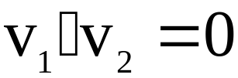
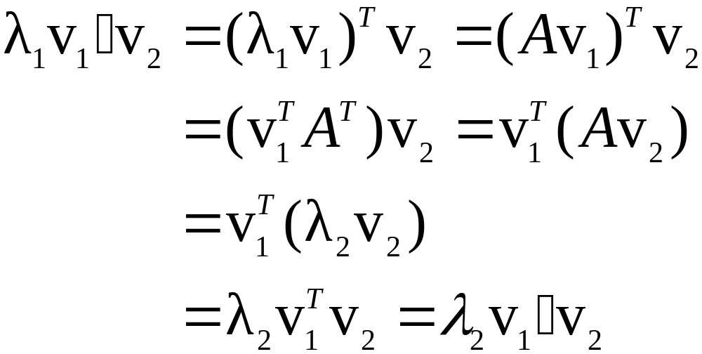

SYMMETRIC MATRIX
Theorem 1: If A is symmetric, then any two eigenvectors from different eigenspaces are orthogonal.
Proof: Let v₁ and v₂ be eigenvectors that correspond to distinct eigenvalues, say, λ₁ and λ₂.
To show that , compute
Since v₁ is an eigenvector
Since
Since v₂ is an eigenvector

Slide 4
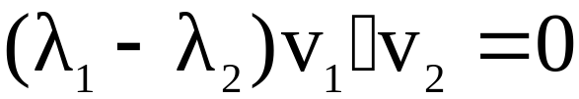
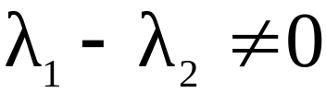
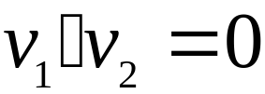



SYMMETRIC MATRIX
Hence .
But , so .
An matrix A is said to be orthogonally diagonalizable if there are an orthogonal matrix P (with ) and a diagonal matrix D such that
----(1)
Such a diagonalization requires n linearly independent and orthonormal eigenvectors.
When is this possible?
If A is orthogonally diagonalizable as in (1), then

Slide 5
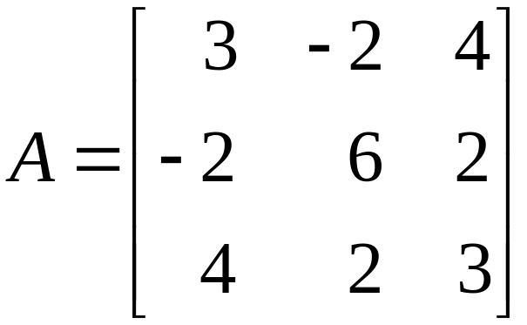
SYMMETRIC MATRIX
Thus A is symmetric.
Theorem 2: An matrix A is orthogonally diagonalizable if and only if A is symmetric matrix.
Example 1: Orthogonally diagonalize the matrix
, whose characteristic equation is

Slide 6
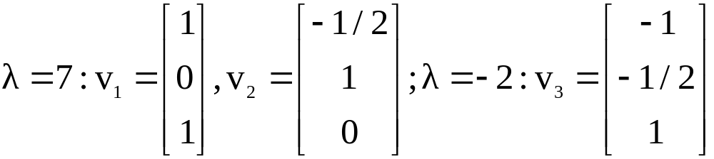
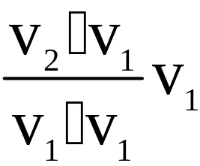
SYMMETRIC MATRIX
Solution: The usual calculations produce bases for the eigenspaces:
Although v₁ and v₂ are linearly independent, they are not orthogonal.
The projection of v₂ onto v₁ is .

Slide 7
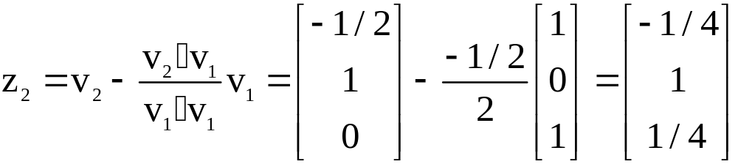

SYMMETRIC MATRIX
The component of v₂ orthogonal to v₁ is
Then {v₁, z₂} is an orthogonal set in the eigenspace for .
(Note that z₂ is linear combination of the eigenvectors v₁ and v₂, so z₂ is in the eigenspace).

Slide 8
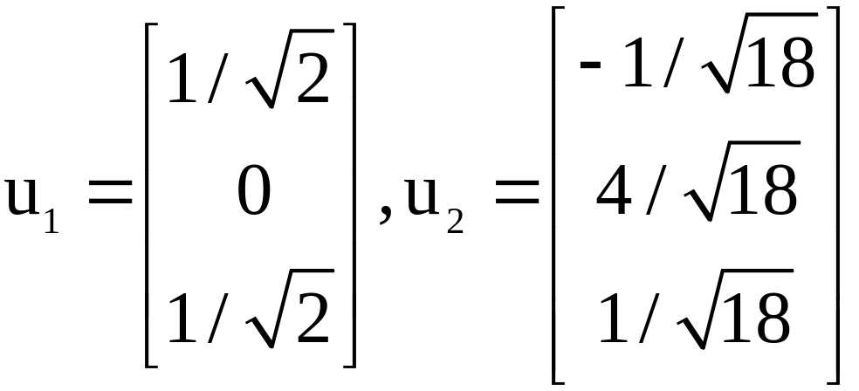
SYMMETRIC MATRIX
Since the eigenspace is two-dimensional (with basis v₁, v₂), the orthogonal set {v₁, z₂} is an orthogonal basis for the eigenspace, by the Basis Theorem.
Normalize v₁ and z₂ to obtain the following orthonormal basis for the eigenspace for :

Slide 9

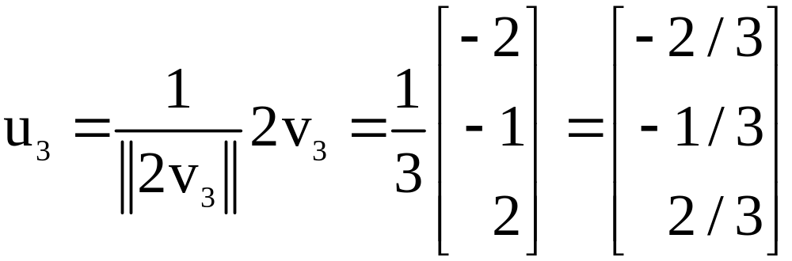
SYMMETRIC MATRIX
An orthonormal basis for the eigenspace for is
By Theorem 1, u₃ is orthogonal to the other eigenvectors u₁ and u₂.
Hence {u₁, u₂, u₃} is an orthonormal set.

Slide 10
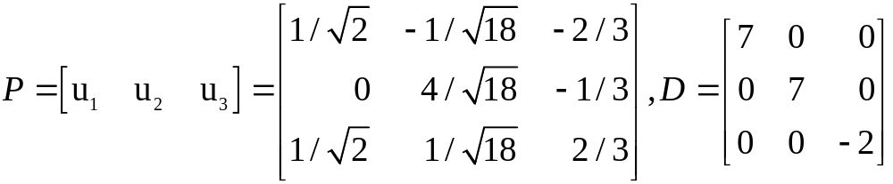

SYMMETRIC MATRIX
Let
Then P orthogonally diagonalizes A, and .

Slide 11
THE SPECTRAL THEOREM
The set if eigenvalues of a matrix A is sometimes called the spectrum of A, and the following description of the eigenvalues is called a spectral theorem.
Theorem 3: The Spectral Theorem for Symmetric Matrices
An symmetric matrix A has the following properties:
    A has n real eigenvalues, counting multiplicities.

Slide 12
THE SPECTRAL THEOREM
    The dimension of the eigenspace for each eigenvalue λ equals the multiplicity of λ as a root of the characteristic equation.
    The eigenspaces are mutually orthogonal, in the sense that eigenvectors corresponding to different eigenvalues are orthogonal.
    A is orthogonally diagonalizable.

Slide 13
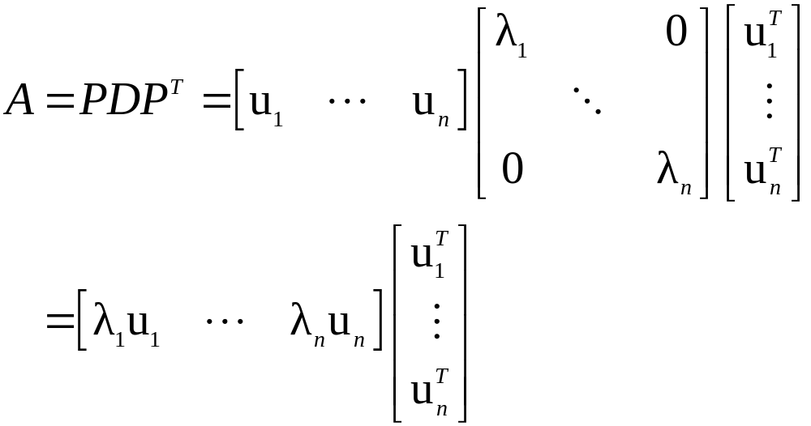
SPECTRAL DECOMPOSITION
Suppose , where the columns of P are orthonormal eigenvectors u₁,…,u_{n} of A and the corresponding eigenvalues λ₁,…,λ_{n} are in the diagonal matrix D.
Then, since ,

Slide 14
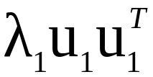


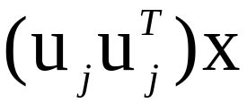
SPECTRAL DECOMPOSITION
Using the column-row expansion of a product, we can write
----(2)
This representation of A is called a spectral decomposition of A because it breaks up A into pieces determined by the spectrum (eigenvalues) of A.
Each term in (2) is an matrix of rank 1.
For example, every column of is a multiple of u₁.
Each matrix is a projection matrix in the sense that for each x in , the vector is the orthogonal projection of x onto the subspace spanned by u_{j}.

Slide 15
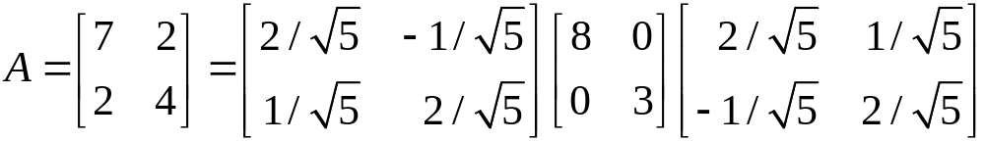
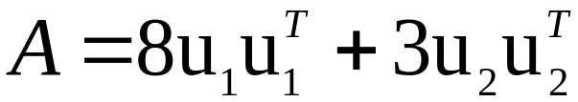
SPECTRAL DECOMPOSITION
Example 2: Construct a spectral decomposition of the matrix A that has the orthogonal diagonalization
Solution: Denote the columns of P by u₁ and u₂.
Then

Slide 16
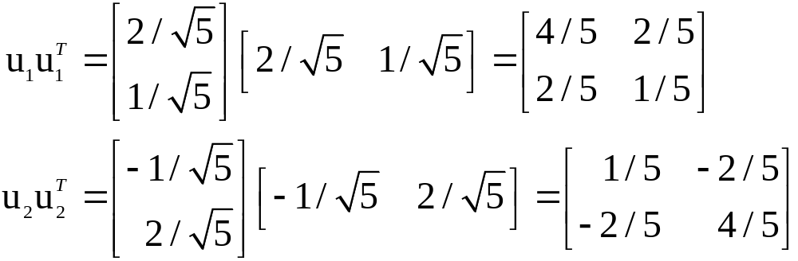
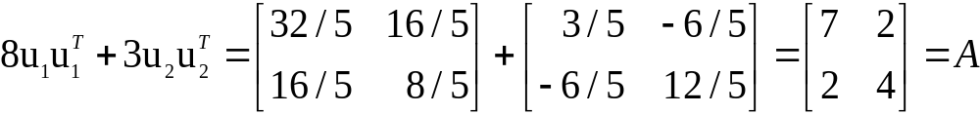
SPECTRAL DECOMPOSITION
To verify the decomposition of A, compute
and

